Slide 1
Growth Investments
North America
Aug YTD & F7 FY Outlook

Slide 2
Executive Summary
A Wide Range Of Strategic Initiatives…
YTD Performance
Sales ($12M) VF7 | +$37M VOP
Operating Expense +$1M VF7
FY Outlook
Sales +$112M VOP
$34M FY Investment
F9 Changes
~$9M Additional Investments Approved
More Realistic Assumptions Around Hiring Timing
2022
Maintain 2021 Momentum
…In Channels, Brands, And Capabilities
Notes:
Add OM Multiplier
Top Right _> FY 20, 2H 20, FY ‘21 rows
Columns AGM, SGA, OM Rate

Slide 3
Aug YTD Actuals

Slide 4

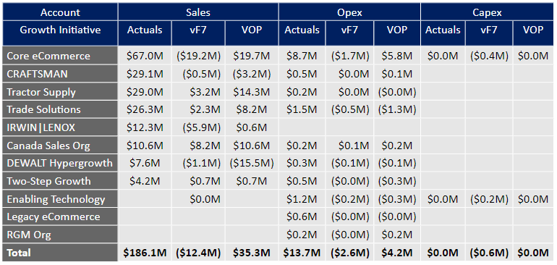
North America Growth Investments – YTD Actuals
Top Line Pressure VF7…
Commentary
Sales (+$12M) VF7
eCommerce ($15M), IRWIN | LENOX ($3M), Canada +$3M, TSC +$2M
Operating Expense +$1M VF7
+$0.5M eCommerce Amazon Timing
+$0.3M Enabling Technology Due To Incremental Anaplan Spend
Capital Expense Essentially Flat VF7
…With Slightly Elevated Investment Activation

Slide 5
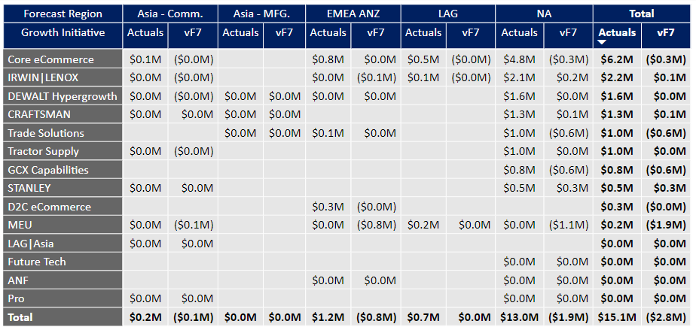
GCX Regional Split - YTD Actuals
GCX Global Investments – YTD Actuals
Regional Breakout Of GCX Operating Expense
Notes:
textbox
No alt text provided.
image
No alt text provided.
shape
No alt text provided.
slicer
No alt text provided.
slicer
No alt text provided.
pivotTable
No alt text provided.

Slide 6
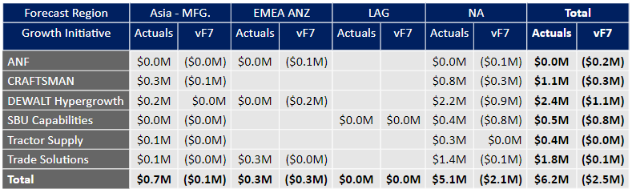
GCX Regional Split - YTD Actuals
PTG Global Investments – YTD Actuals
Regional Breakout Of PTG Operating Expense
Notes:
textbox
No alt text provided.
image
No alt text provided.
shape
No alt text provided.
slicer
No alt text provided.
slicer
No alt text provided.
pivotTable
No alt text provided.

Slide 7
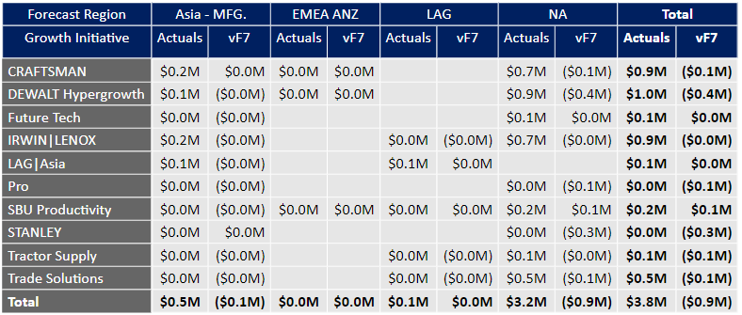
HTAS Regional Split - YTD Actuals
HTAS Global Investments – YTD Actuals
Regional Breakout Of HTAS Operating Expense
Notes:
textbox
No alt text provided.
image
No alt text provided.
shape
No alt text provided.
slicer
No alt text provided.
slicer
No alt text provided.
pivotTable
No alt text provided.

Slide 8
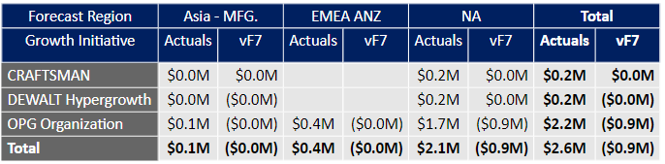
OPG Regional Split - YTD Actuals
OPG Global Investments – YTD Actuals
Regional Breakout Of OPG Operating Expense
Notes:
textbox
No alt text provided.
image
No alt text provided.
shape
No alt text provided.
slicer
No alt text provided.
slicer
No alt text provided.
pivotTable
No alt text provided.

Slide 9
F7 FY Outlook

Slide 10
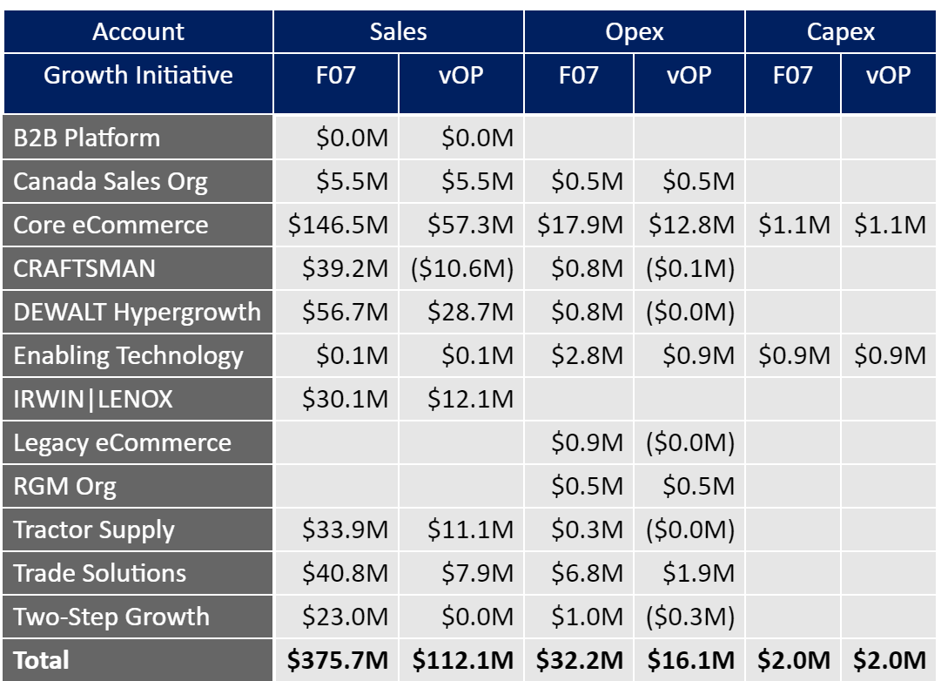
North America Growth Investments – FY Outlook
Sales Outperformance…
Commentary
Sales +$112M VOP
Outperformance Across Most Initiatives
Operating Expense +$16M VOP
Incremental Investment Around eCommerce, Trade Solutions, RGM, Technology & Canada
F9 Changes
Delay 4Q Open Roles To 1Q22
Reduce 4Q Non-C&B Spend.
…Leading To Incremental Investment

Slide 11
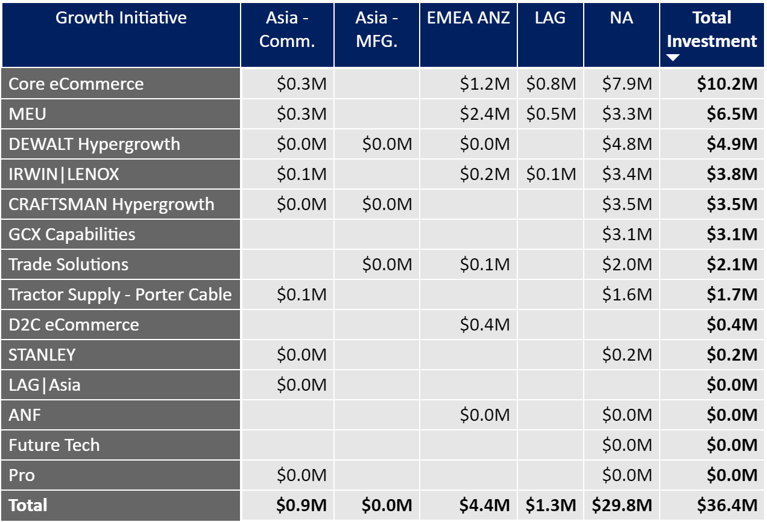
GCX Regional Split - FY Outlook
GCX Global Investments – FY Outlook
Regional Breakout Of GCX Operating Expense
Notes:
textbox
No alt text provided.
image
No alt text provided.
shape
No alt text provided.
slicer
No alt text provided.
slicer
No alt text provided.
pivotTable
No alt text provided.

Slide 12
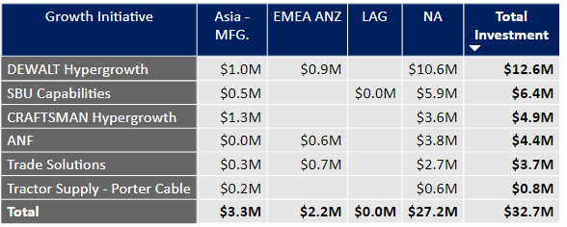
PTG Regional Split - FY Outlook
PTG Global Investments – FY Outlook
Regional Breakout Of PTG Operating Expense
Notes:
textbox
No alt text provided.
image
No alt text provided.
shape
No alt text provided.
slicer
No alt text provided.
slicer
No alt text provided.
pivotTable
No alt text provided.

Slide 13
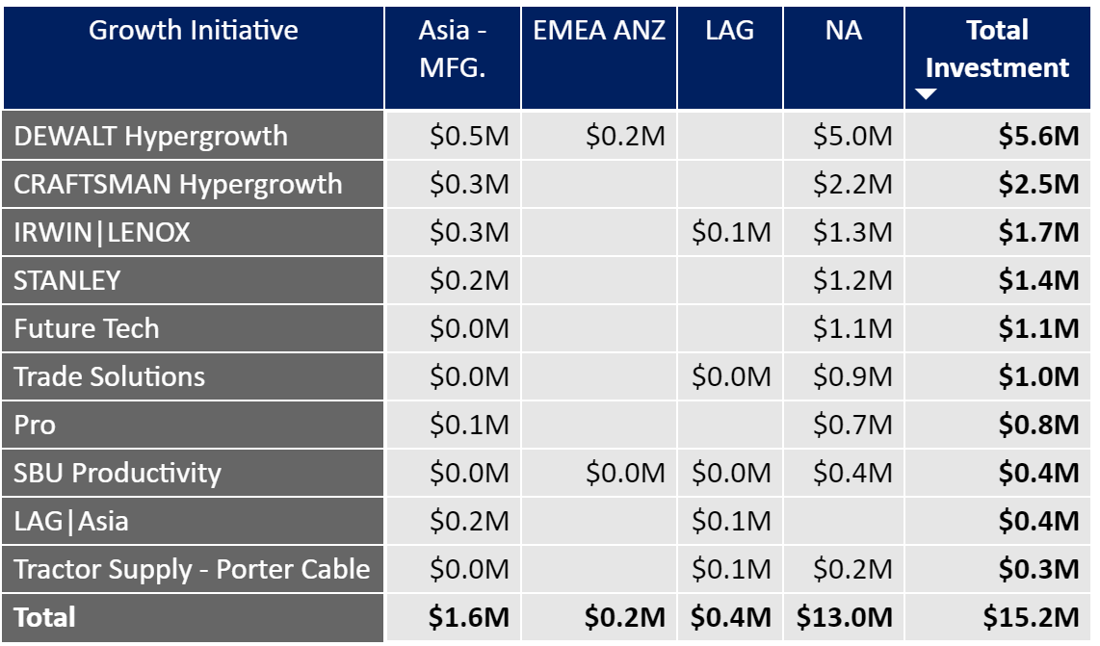
HTAS Regional Split - FY Outlook
HTAS Global Investments – FY Outlook
Regional Breakout Of HTAS Operating Expense
Notes:
textbox
No alt text provided.
image
No alt text provided.
shape
No alt text provided.
slicer
No alt text provided.
slicer
No alt text provided.
pivotTable
No alt text provided.

Slide 14
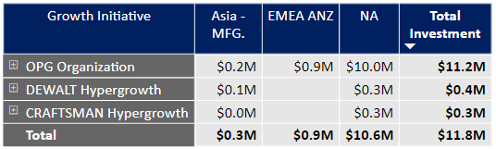
OPG Regional Split - FY Outlook
OPG Global Investments – FY Outlook
Regional Breakout Of OPG Operating Expense
Notes:
textbox
No alt text provided.
image
No alt text provided.
shape
No alt text provided.
slicer
No alt text provided.
slicer
No alt text provided.
pivotTable
No alt text provided.

Slide 15
Project Plan
Early Successes From Growth Initiatives…
YTD Accomplishments
Showpad & Salesforce Lightning Successfully Launched
Craftsman Pressure Washer Test Underway (+290 Stores)
DEWALT Interns In-Stores At THD
Upcoming Milestones & Deliverables |  |  |  | Project Status:
Item Name | Owner | Due Date | Status | Comments
eCommerce Funnel Testing | Monasebian | 3Q21 |  | Amazon Investment
DEWALT Atomic NPD Launches | Doehne | 3Q21 |  | Component Shortages Could Impact
Fully Staff Trade Solutions Org | Collins | 4Q21 |  | 77 FTEs To Fill
TSC 500 Store Fusion Set | Cooley | 4Q21 |  | 60% Of Stores Set To-Date
CRAFTSMAN RP+ Launch | Snellenburg | 1Q22 |  | Premier Brushless Tools
Key Constraints / Risks | Mitigation Plan
Aggressive Hiring Assumptions | Add | Focus Talent Acquisition Resources
…And Building Capabilities For Sustained Growth
15

Slide 16
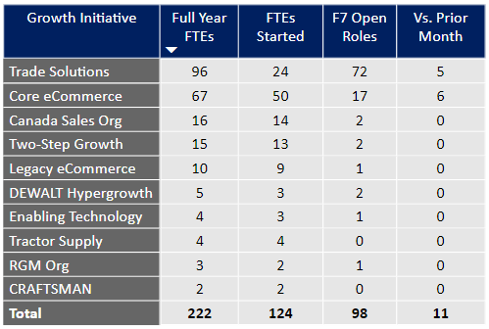
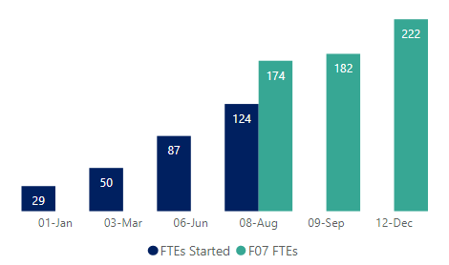
Hiring Strategy
51% Staffed As Of July…
Commentary
26 Started During July
+2 Above 24 Estimated In F7
Hiring ~14 Heads Per Month
11 Offers Accepted | 74 Open Reqs
24 Roles Not Yet Posted
…With Steep Ramp Forecasted For Trade Solutions And eCommerce
16

Slide 17
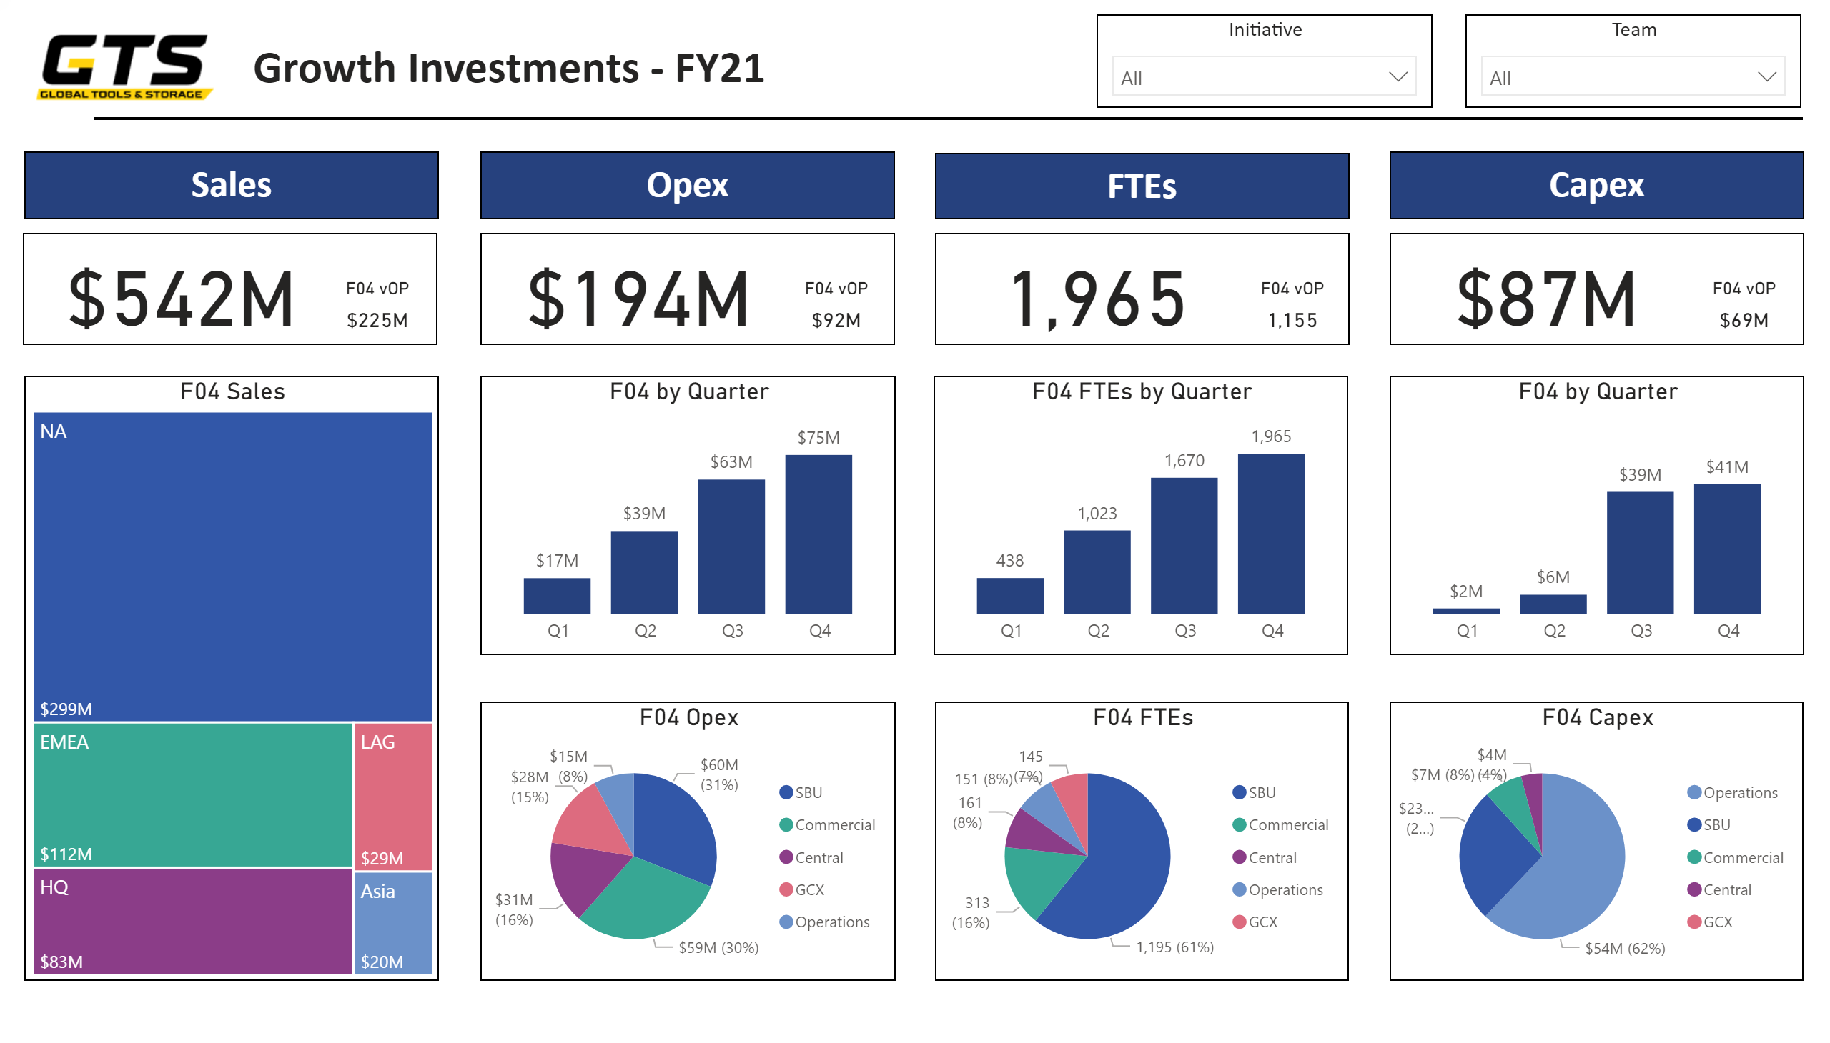
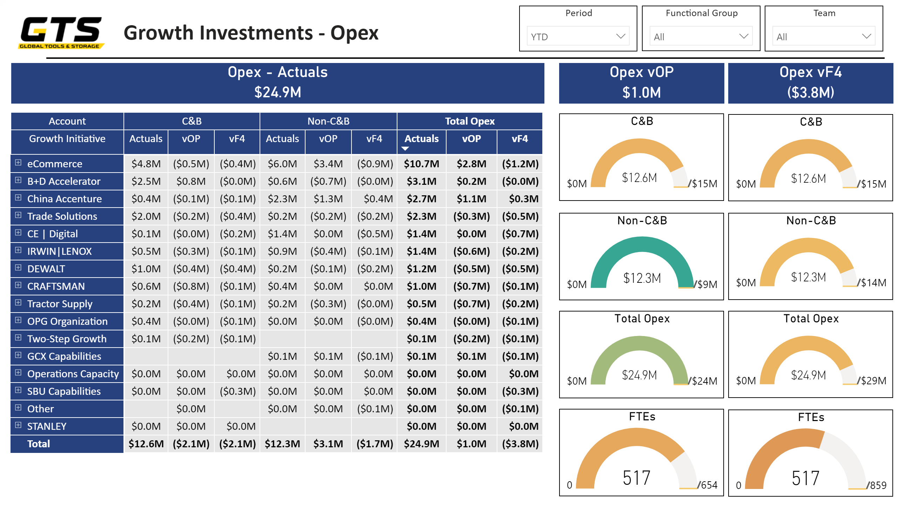
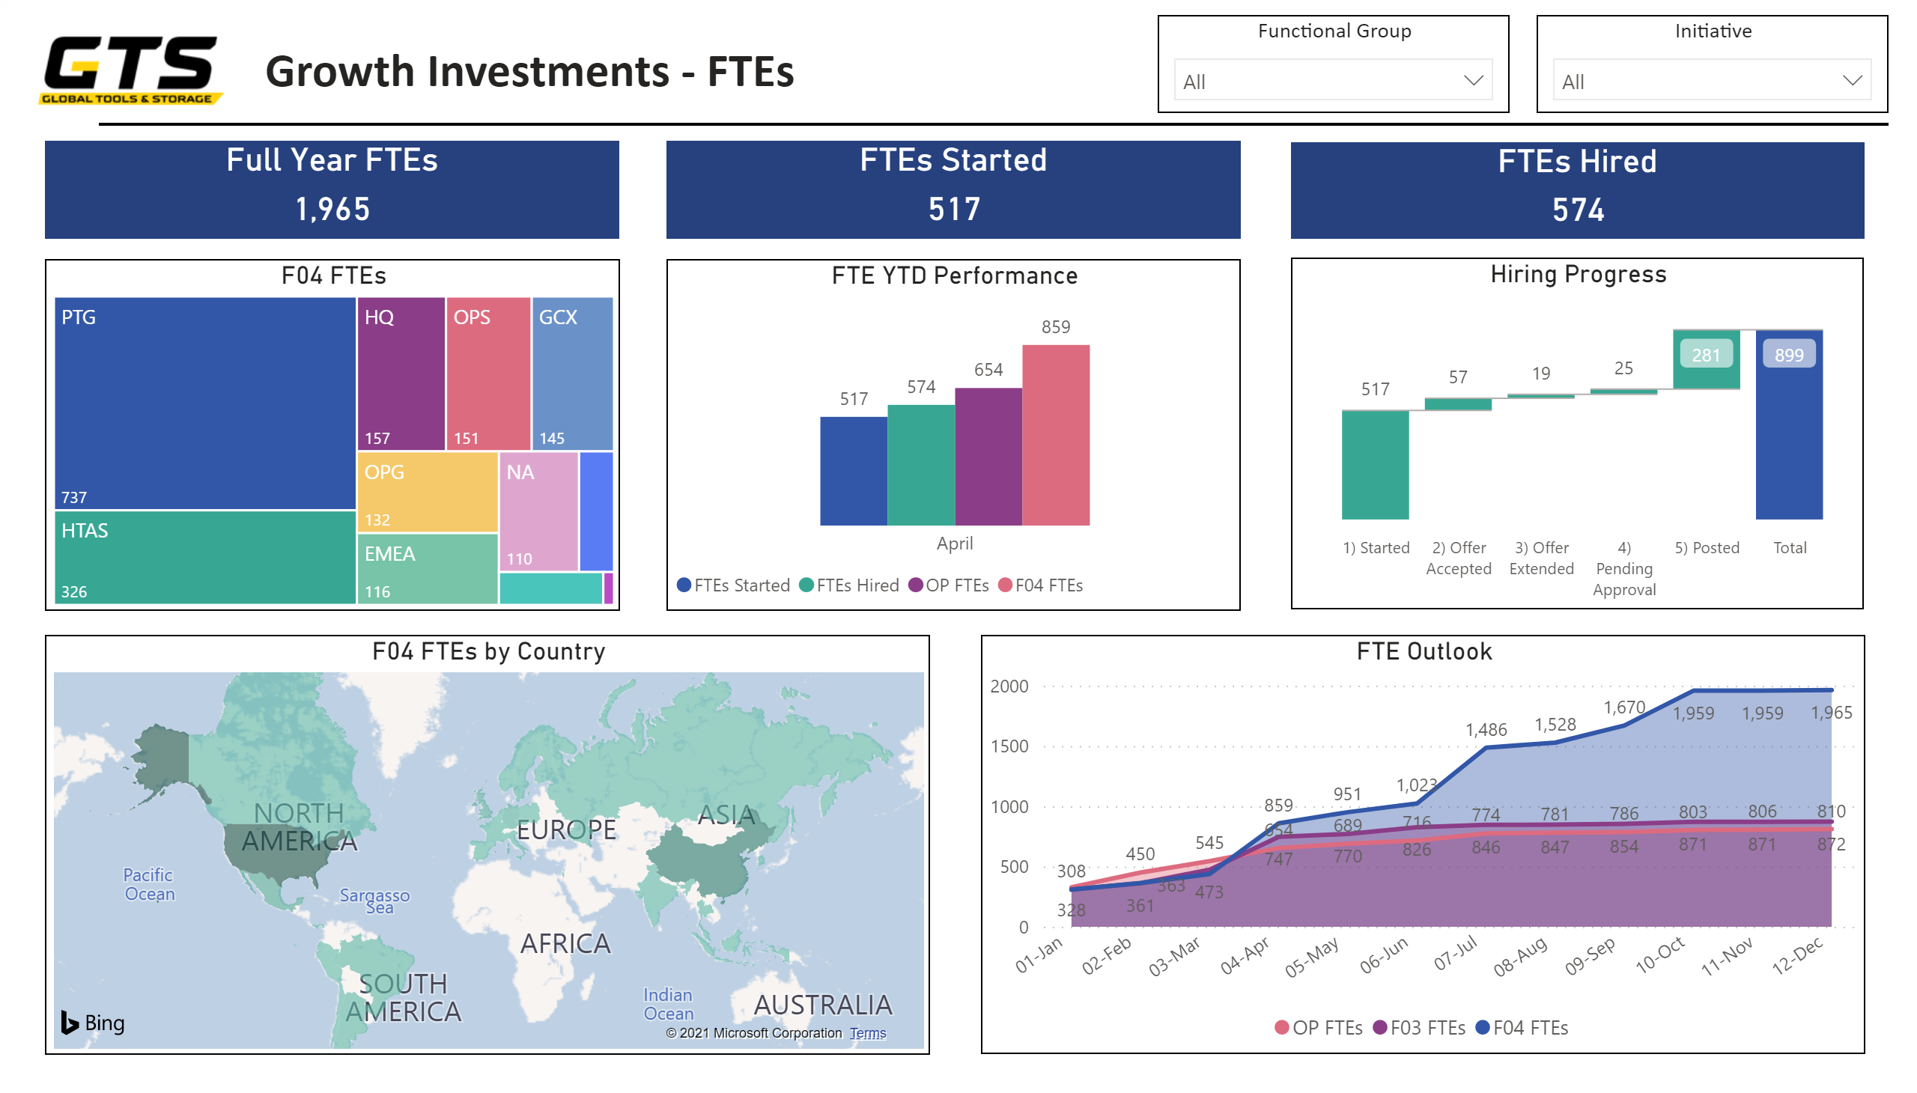
Growth Dashboard
Global Growth Investment Dashboard…
Investment Overview
Opex Performance
FTE Analytics
Designed To Democratize Growth Investment Data Cross-Functionally Across The Globe
Includes Slicers To Cut The Data By Team, Initiative, Period, And Functional Group
Follow This Link To Access The Dashboard - Best In Chrome
Sign-In, Select “Power BI Portal”, Select “Shared With Me”, And Click On The “Growth Investments” Report
…To Provide Insights That Drive Strategic Execution
17

